Slide 1

Data 602 Term Project
GROUP 12
JORDAN KEELAN
ALI RAZA
ABRIE LE ROUX

Slide 2
Background
Gain an understanding of overnight occupancy in emergency homeless shelters across the province of Alberta from 2013 to 2022.
During this time, there were major downturns in the price of oil, a commodity heavily linked to Alberta’s economy (September 2014 and March 2020)(Government of Alberta, 2022)
Topic of Investigation #1: Which economic downturn, brought on by the 2014 crash in oil prices and/or COVID-19 pandemic had a larger effect on homeless shelter occupancy?
Does crippling the province’s biggest industry create a larger homelessness problem?
Topic of Investigation #2: Which economic downturn resulted in a higher proportion of occupants in women emergency shelters?
“Shadow Pandemic” of increased domestic violence catalyzed by increased time spent indoors, coupled with joblessness resulting in an inability to move away from abusive situations (Sawhney).

Slide 3
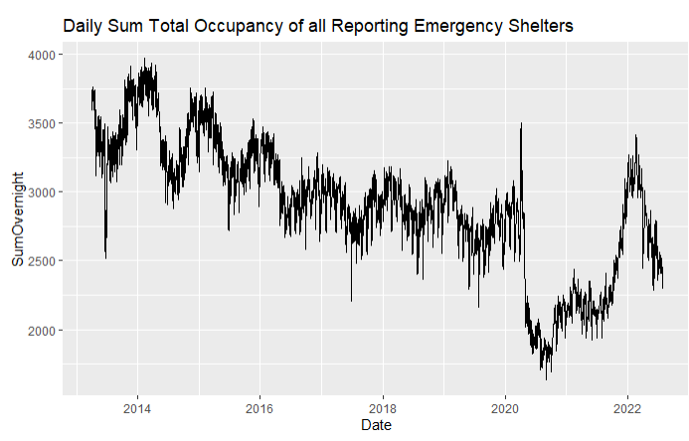
The Dataset
Emergency Shelters Daily Occupancy AB - Emergency Shelters Daily Occupancy AB - 2013-22” (Alberta Government, 2022).
Daily occupancy data from 16 municipalities over multiple different shelter types.
Removed “COVID-19 Isolation Sites” – Quarantining purposes only.
April 2013 to July 2022.
Shelters adapting to social distancing measures.
Vaccine development.
Fear?

Slide 4
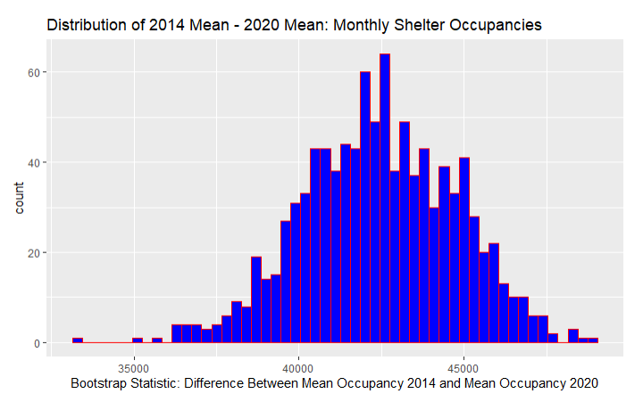
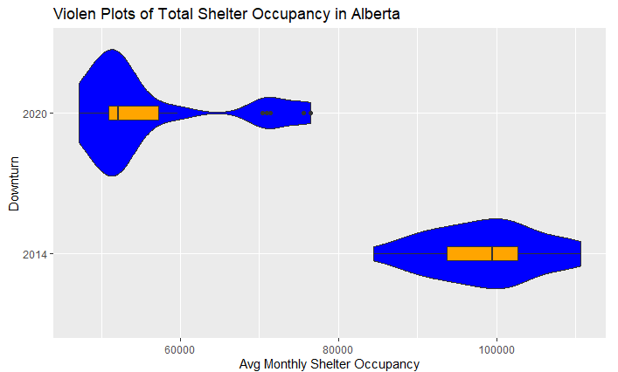

Topic of Investigation #1
Initial steps were to look at the difference in mean monthly occupancy between two different 24-month datasets.
24 months chosen as the dataset only included 28 months of data after March 2020.
October 2014 to September 2016
April 2020 to March 2022.

Slide 5
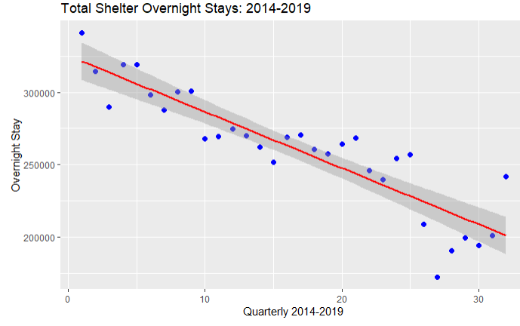

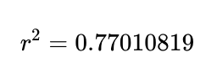

Topic of Investigation #1 - Cont.
To look for any linear correlations, first divided the time data into yearly quarters and indexed the quarters.

Slide 6
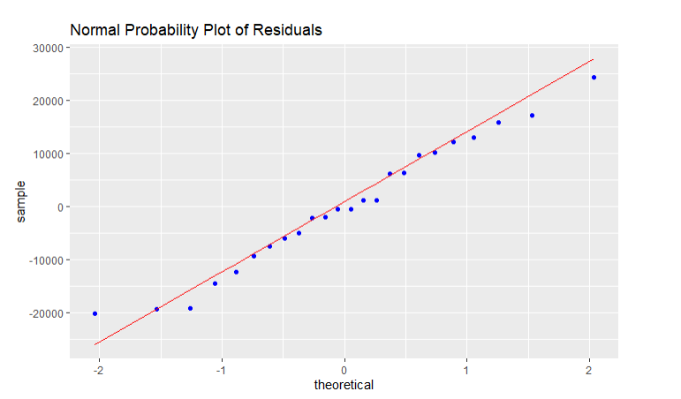
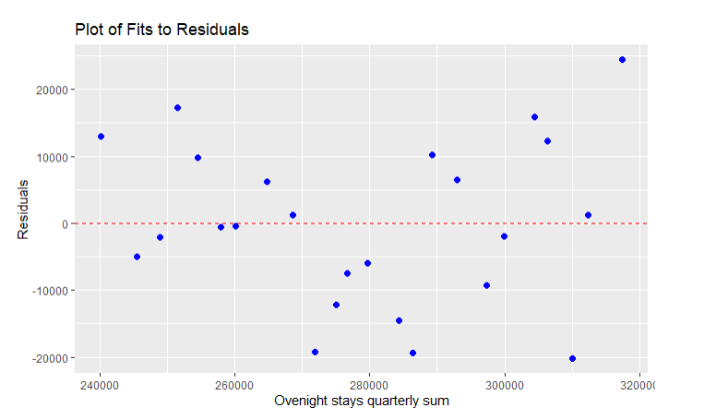
Topic of Investigation #1 - Cont.
Condition checking
The plots above show (1) the residuals are normally distributed and (2) the residuals vs. predicted values show no clear distribution and the sum of the residuals = 1.0e-11, further supporting homoscedasticity.

Slide 7

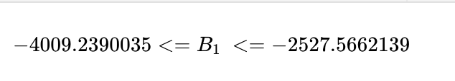
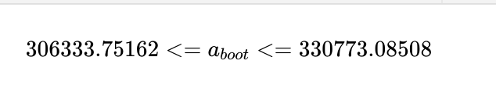

Topic of Investigation #1 - Cont.
Hypothesis Development:
Calculated P-value of 5.47e-9. Therefore we rejected the null hypothesis and concluded that the slope of the linear model is <0.
95% CI on β₁: -4009 to -2528
95% CI on A: 306,334 to 330,773
95% CI on r: -0.9440 to -0.8209
Predicted shelter occupancy for Q2 2022: 208,719
95% CI on predicted shelter occupancy for Q2 2022: 191,389 to 226,049
Actual shelter occupancy in Q2 2022: 194,373
Notes:
In line with the trend

Slide 8
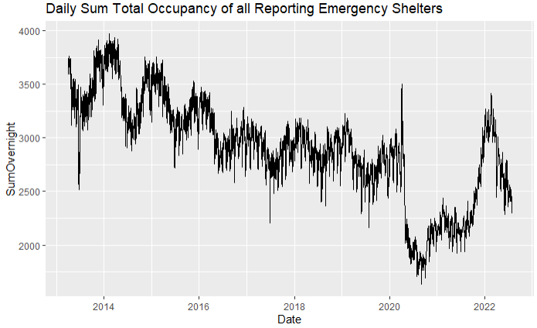
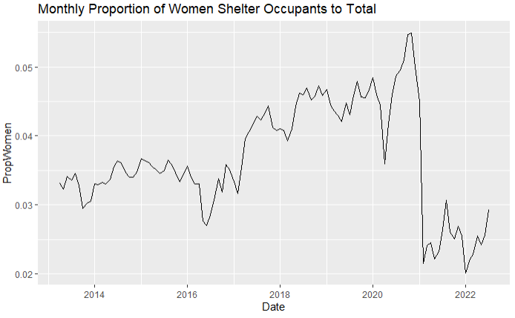
Proportion of Women Emergency Shelters
Analysis of difference of proportion for “women emergency” shelter occupants to total emergency shelter occupants, between the covid-19 pandemic and the 2014 economic downturn
As total occupancy of all emergency shelters has fallen year over year, this proportion analysis allows us to compare the environments of the two time-periods relative to themselves

Slide 9
Women Emergency Cont.
“Shadow Pandemic” (Sawhney) – This informed our hypothesis
With lockdowns causing increased time at home, loss of employment, and elevated stress, cases of domestic violence saw sharp rise in 2020
Our hypothesis tests if women emergency shelters made up a larger proportion of total emergency shelter occupants in during the COVID-19 pandemic than in the two years following the economic downturn in 2014

Slide 10
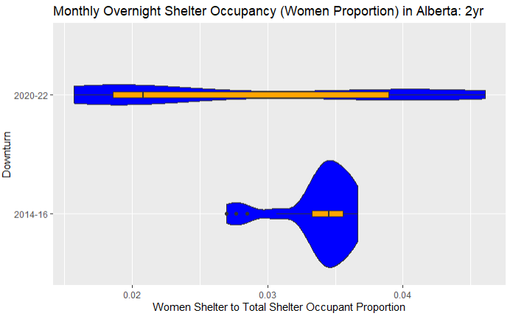
Women Emergency Cont.
Significantly larger IQR in 2020-2022
Median 2020-22 value appears well below 2014-16
2020-22 median shows right skew, non-parametric analysis necessary

Slide 11
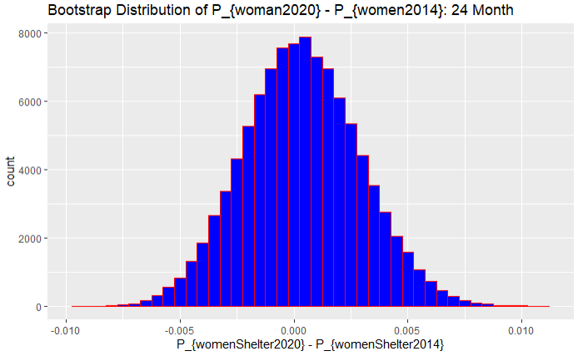
Women Emergency Bootstrap 24 Month
Bootstrap distribution of difference of proportion straddles 0
95%CI: -0.0045 < p₂₀₂₀- p₂₀₁< 0.0054
Implies no difference

Slide 12
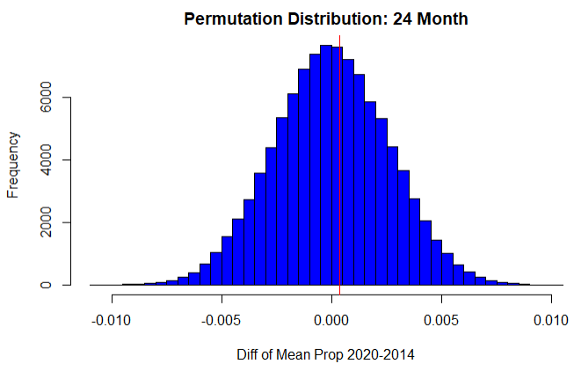
Women Emergency Permutation 24 Month
Permutation distribution of difference of proportion means
p-value: 0.4466
Implies very probable observed result

Slide 13
Women Emergency 24 Month Conclusion
At 95% Confidence level, we fail to reject the null hypothesis.
No statistical evidence to suggest that Women Shelter to Total Population proportion of total emergency shelter occupants was greater during the first 24 months of the COVID19 pandemic than during the first 24 months of the 2014 economic downturn

Slide 14
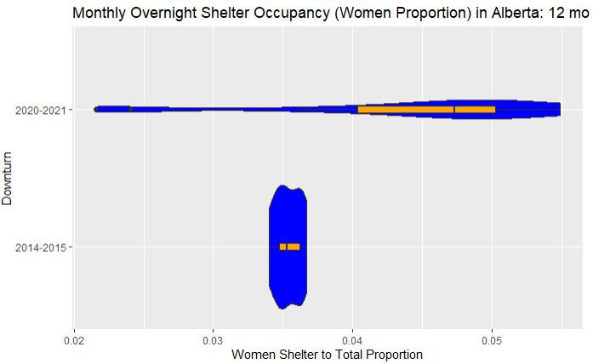
Women Emergency 12 Month
2021 contained strongest restrictions, loss of employment (Makowichuk)
Proportion chart below indicates greatest impact from COVID19 in first 12 months

Slide 15
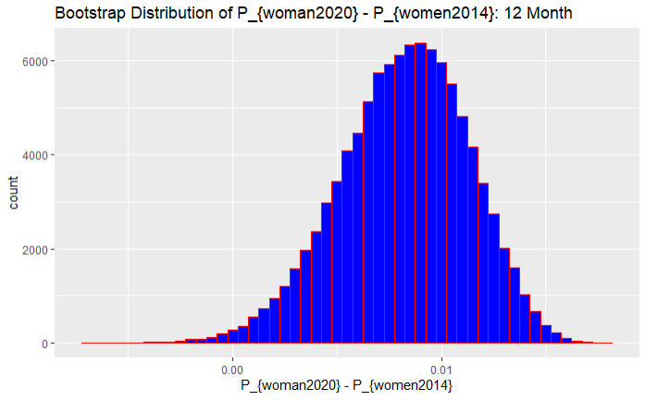
Women Emergency Bootstrap 12 Month
Bootstrap distribution of difference of proportion largely positive
95%CI: 0.0018 < p₂₀₂₀- p₂₀₁₄ < 0.0137
Implies larger p₂₀₂₀

Slide 16
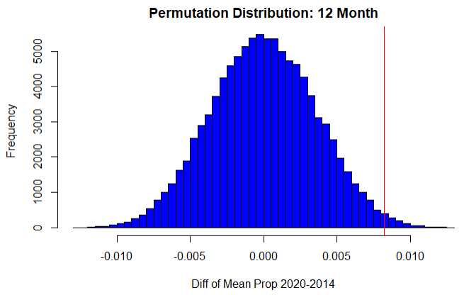
Women Emergency Permutation 12 Month
P_{woman2020}-P_{woman2014}=0.0082
Permutation distribution of difference of proportion means
p₂₀₂₀- p₂₀₁₄ = 0.0082
p-value: 0.0088
Observed difference very unlikely

Slide 17
Women Emergency 12 Month Conclusion
At 95% Confidence level, we reject the null hypothesis.
Statistical evidence suggests that Women Shelter to Total Population proportion of total emergency shelter occupants was greater during the first 12 months of the COVID19 pandemic than during the first 12 months of the 2014 economic downturn

Slide 18
Conclusions and Next Steps
Strong negative linear correlation modeling the decline in homeless shelter occupancy in Alberta from 2013 to 2019.
95% CI on r-value: -0.9440 to -0.8209.
95% CI on prediction of quarterly occupancy in Q2 2022: 191,389 to 226,049. The actual value of 194,373 shows no increase in shelter occupancy post-COVID-19, once the virus became endemic.
Looking at other provinces where oil isn’t the main economic driver, do they see similar trends? Does government spending impact this more than environmental forces?
At 24 months, we cannot conclude that the COVID19 pandemic saw a greater proportion of shelter seekers from Women Shelters than the 2014 downturn
At 12 months we can conclude that the COVID19 pandemic saw a greater proportion of shelter seekers from Women Shelters than the 2014 downturn
Further investigation would investigate if this relationship is true for Youth Shelter proportion or Family Shelters
The large spike in women proportion from 2016-2019 is interesting, next steps to identify indicators of when the greatest economic impact on citizens was due to the 2014 downturn

Slide 19
Works Cited
“11.5 Symmetric and skewed data | Statistics.” Siyavula, https://ng.siyavula.com/read/maths/grade-11/statistics/11-statistics-05. Accessed 18 October 2022.
Government of Alberta, 2019. “Emergency Shelters Daily Occupancy AB - Emergency Shelters Daily Occupancy AB - 2013-22.” Open Government Program, 8 February 2019, https://open.alberta.ca/dataset/funded-emergency-shelters-daily-occupancy-ab/resource/b7080b66-25ea-4c30-ac47-02b64353637f. Accessed 18 October 2022.
Government of Alberta, 2022. “Oil Prices.” Alberta Economic Dashboard, http://economicdashboard.alberta.ca/oilprice. Accessed 18 October 2022.
Makowichuk, Darren. “Two years of COVID-19: A timeline of the pandemic in Alberta.” Calgary Herald, 15 March 2022, https://calgaryherald.com/news/local-news/two-years-of-covid-19-a-timeline-of-the-pandemic-in-alberta. Accessed 18 October 2022.
Sawhney, Rajan. “The 'shadow' pandemic | Alberta.ca.” Government of Alberta, 20 April 2021, https://www.alberta.ca/article-the-shadow-pandemic.aspx. Accessed 17 October 2022.

